Slide 1


AUBG 2025
Used Car Price Prediction System
Aleksandar Ivaylov Ivanov

Slide 2
The problem
The used-car market is unpredictable
Prices depend on many factors (mileage, age, fuel type)
Buyers cannot estimate depreciation accurately
Sellers have difficulty pricing fairly
No widely accessible interactive tool exists

Slide 3
How does the project solve the problem
Uses real historical data to learn pricing patterns
Predicts fair market prices for any car configuration
Provides multi-year depreciation forecasts
Allows side-by-side comparison of two cars
Uses ensemble ML models for high predictive performance
Has user friendly web interface

Slide 4
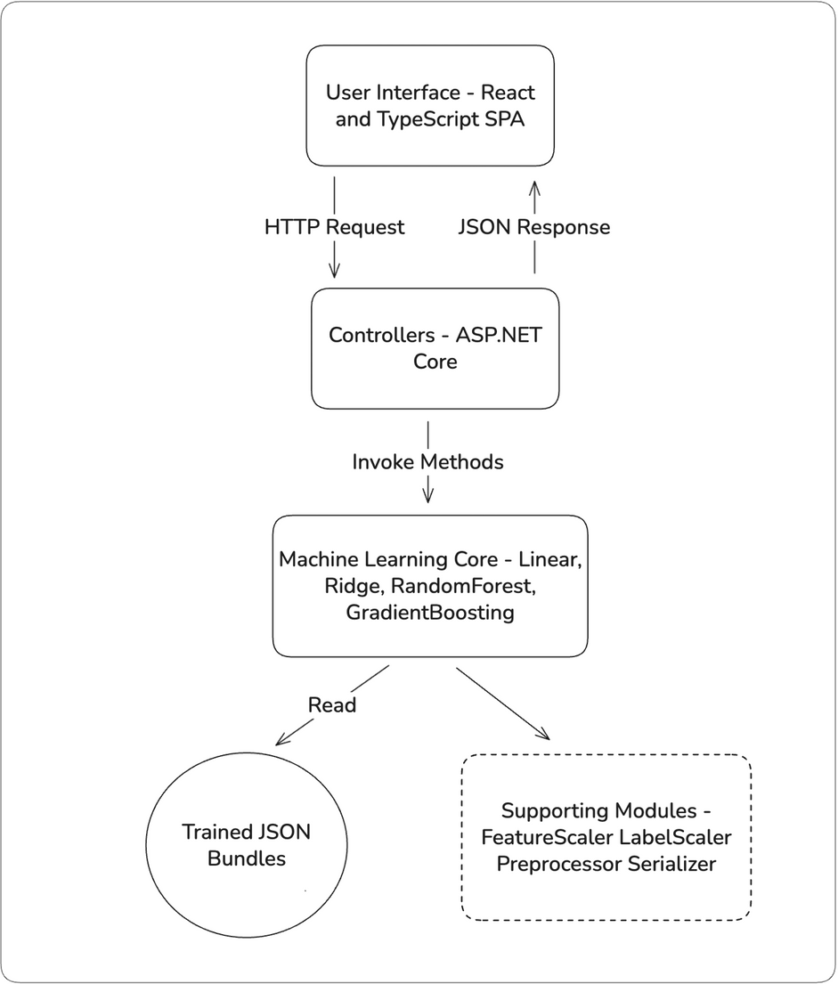
Project overview
ASP.NET Core backend
React + TypeScript frontend
CLI trainer for model building
Custom ML algorithms
Trained model bundles stored as JSON
4 types of predictions (single, comparison, range(single, comparison))

Slide 5
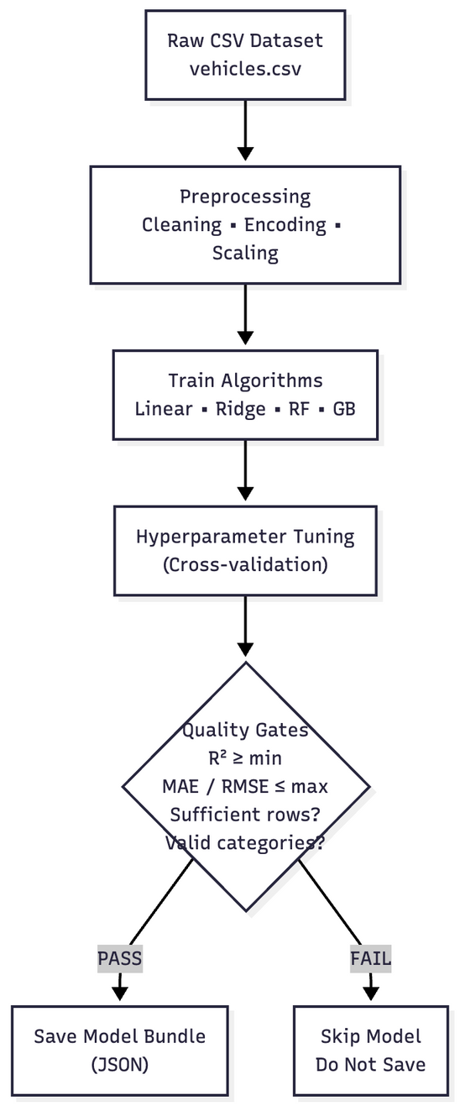
Training Pipeline & Quality Gates
Processes raw vehicle data (cleaning, encoding, feature scaling)
Trains all algorithms on each (make, model) pair
Tunes hyperparameters using cross-validation
Applies strict quality gates (R², MAE, RMSE thresholds)
Skips models with insufficient data or missing categories
Saves only high-quality models as bundles

Slide 6
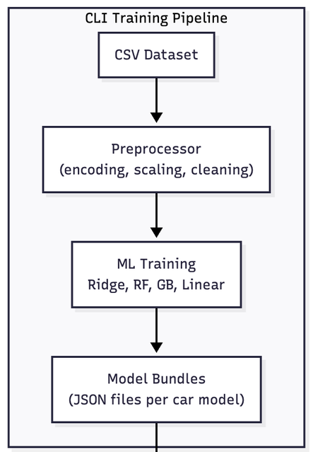
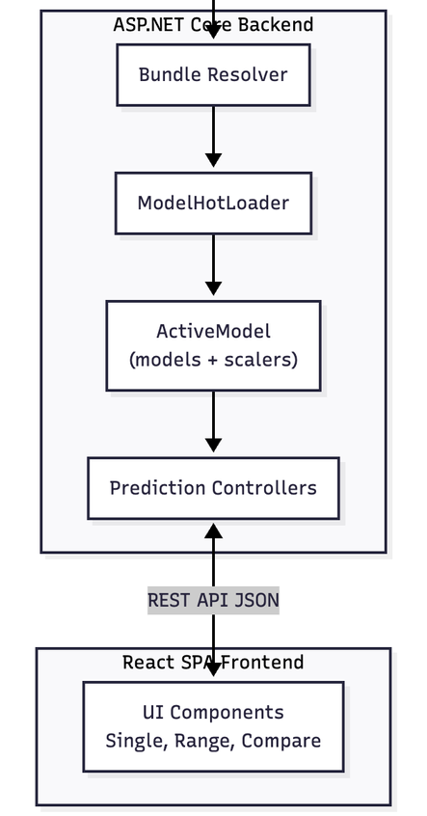
Overview Diagram
ASP.NET Core API (PredictionController, ModelHotLoader, ActiveModel)
React SPA UI (Single prediction, Range prediction, Compare)

Slide 7
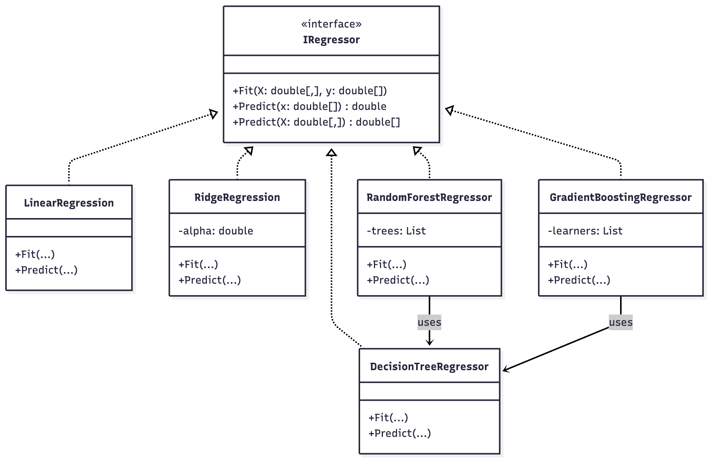
Class Hierarchy

Slide 8
Algorithms used
Linear Regression – provides the simplest baseline for price estimation. Complexity: O(E · n · m)
Ridge Regression – adds stability and prevents overfitting in trend modeling. Complexity: O(m² · n)
Random Forest – captures nonlinear patterns that linear models miss. Complexity: O(t · k · m · log k)
Gradient Boosting – delivers highest accuracy by learning from residual errors. Complexity: O(t · k · m · log k)

Slide 9
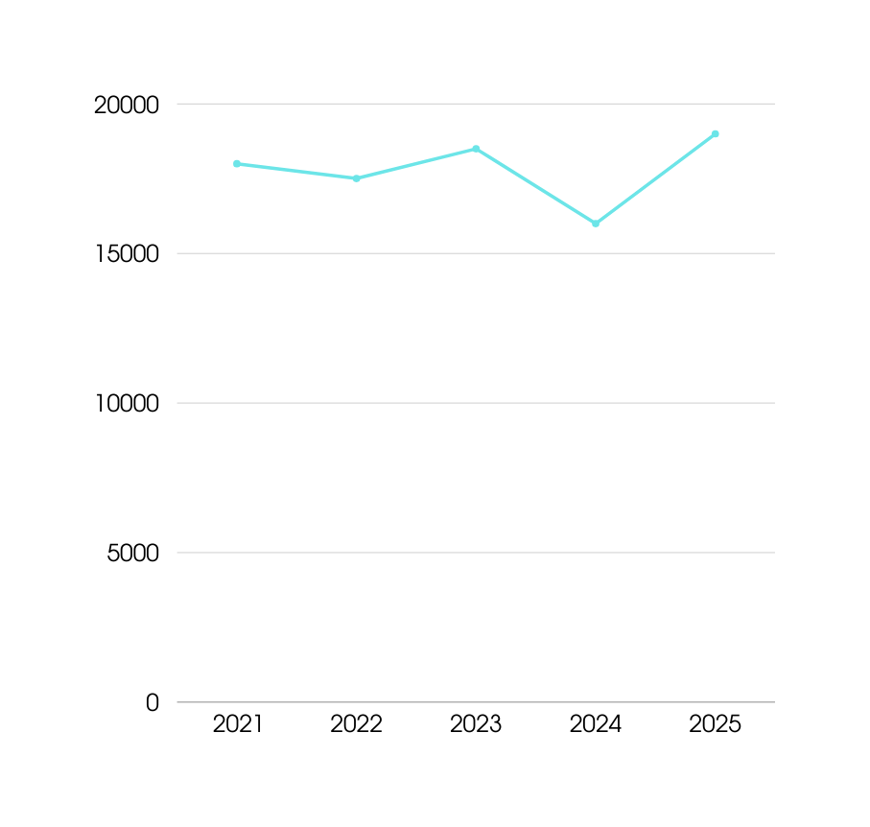
Challenges
RF/GB models were unstable for long-term forecasts → required using Ridge for range predictions
Raw data had inconsistent model names → needed a custom canonical ID system
Ensuring safe model hot-loading

Slide 10
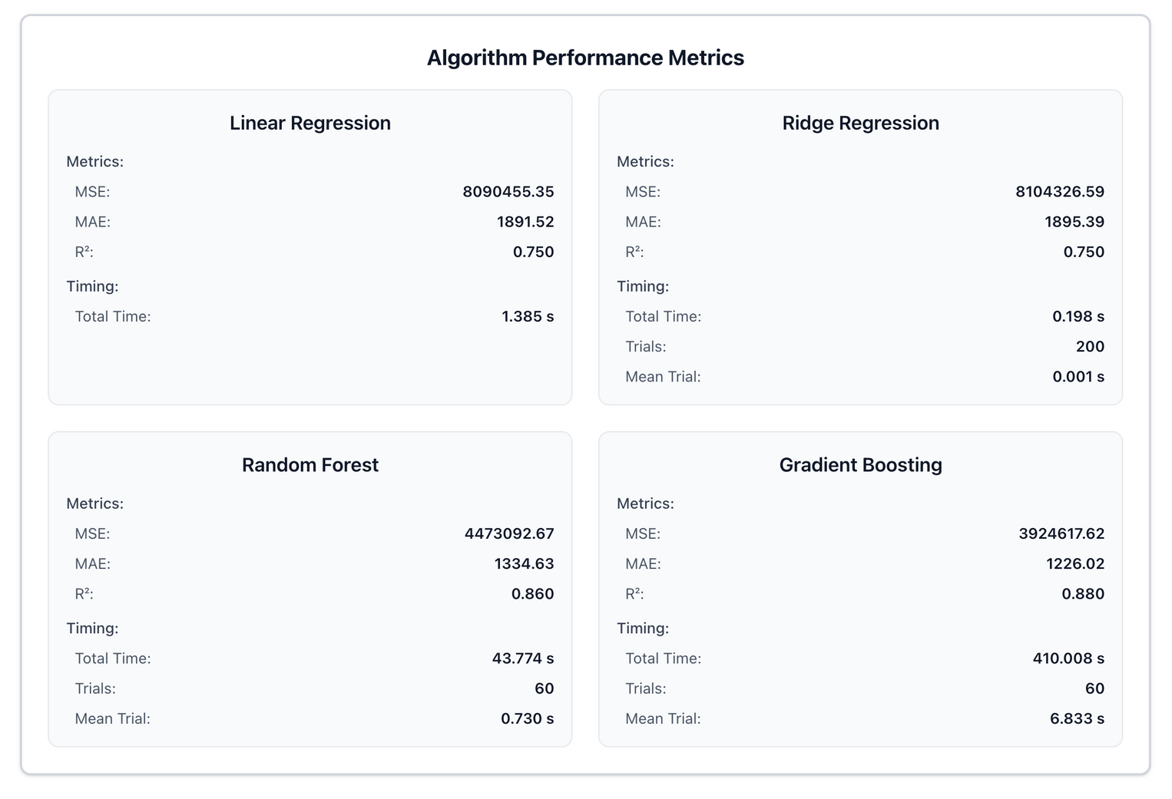
Results & Findings
High model accuracy across most car models (strong MAE/RMSE and R² scores)
RF/GB + Ridge Regression models performed best overall
Strict quality gates prevented weak models from being saved
Backend test coverage: 84%
Frontend test coverage: 98%

Slide 11
Moving to the demo

